Slide 1
Introduction
Operating Systems (CS-2006) Spring 2022, FAST NUCES
COURSE SUPERVISOR: ANAUM HAMID
anaum.hamid@nu.edu.pk

Slide 2
Course Outline
Chapter 1,2
Hardware
Before mid 1
Deadlock/ Disk Scheduling
After mid2
Process/ scheduling
Before and after mid 1
Linux Scripting
C programming
Memory
Before and after mid 2
Multithreading/ Synchronization
mid 2
COURSE SUPERVISOR: ANAUM HAMID

Slide 3
Evaluation Instruments and Marks Distributions
Assignments = 10 marks
Project = 10 marks
Midterm = 30 marks (15 for each)
Final Term = 50 marks
Total = 100 Marks
COURSE SUPERVISOR: ANAUM HAMID

Slide 4
Course Resources
TEXTBOOK:
Operating Systems Concepts, Global edition, by Abraham Silberschatz, Peter Baer Galvin, and Greg Gagne.
REFERENCE BOOKS:
Operating Systems – Internals and Design Principles, 9th edition, by William Stallings.
Operating Systems - Tanenbaum
COURSE SUPERVISOR: ANAUM HAMID

Slide 5

Introduction
Road Map.
What is an Operating System?
OS structures.
Interrupt
I/O
Memory
OS Architecture
Clustered Systems
OS Structure + Operations
Computing Environments
COURSE SUPERVISOR: ANAUM HAMID
Notes:
Chapter 1 provides an overview of computer system hardware. In most areas, the survey is brief, as it is assumed that the reader is familiar with this subject. However, several areas are covered in some detail because of their importance to topics covered later in the book.

Slide 6
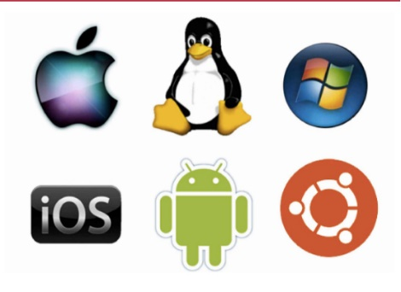
Operating System: Overview
Operating system (OS): a system software that exploits the
hardware resources to provide a set of services to system users.
The OS manages the processor(s), memory and input/output (I/O) devices on behalf of its users.
Note: it is important to have some fundamental understanding of basic data structures, computer organization and a high-level programming language, such as C or Java, before examining topics related to operating systems.
COURSE SUPERVISOR: ANAUM HAMID

Slide 7
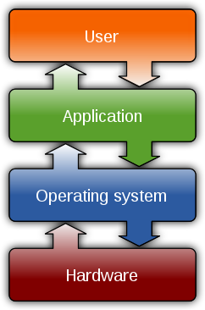
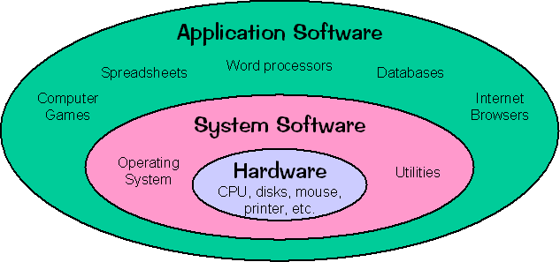
Operating System: Overview (Cont.)
Relationship between application software and system software
COURSE SUPERVISOR: ANAUM HAMID

Slide 8
Computer System Structure
Computer system can be divided into four components:
Hardware – provides basic computing resources
Operating system
Application programs
Users
COURSE SUPERVISOR: ANAUM HAMID

Slide 9
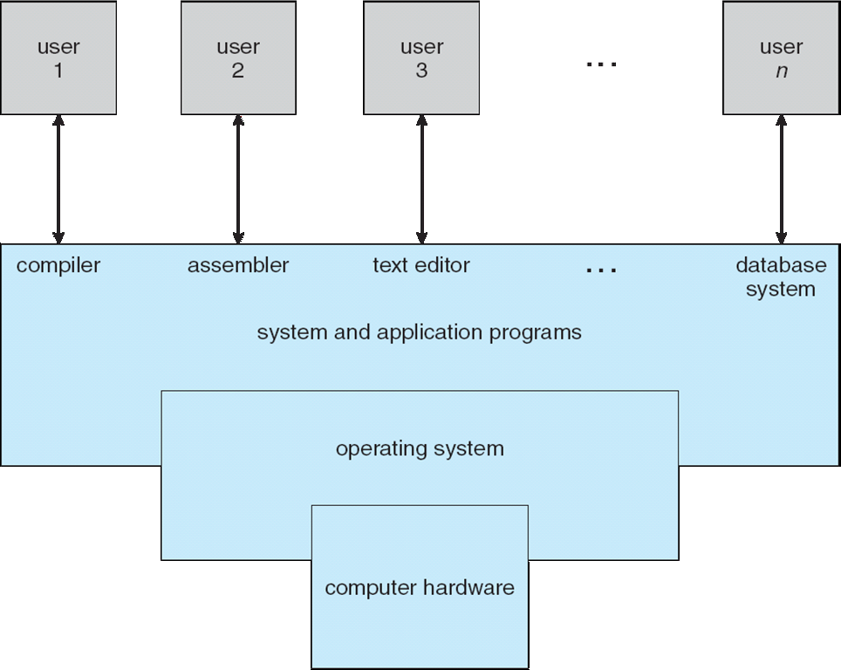
Four Components of a Computer System
COURSE SUPERVISOR: ANAUM HAMID

Slide 10
Operating System Definition
OS is a resource allocator
Manages all resources
Decides between conflicting requests for efficient and fair resource use
OS is a control program
Controls execution of programs to prevent errors and improper use of the computer
COURSE SUPERVISOR: ANAUM HAMID

Slide 11
Computer Startup
bootstrap program is loaded at power-up or reboot
Typically stored in ROM or EPROM, generally known as firmware
Initializes all aspects of system
Loads operating system kernel and starts execution
COURSE SUPERVISOR: ANAUM HAMID

Slide 12
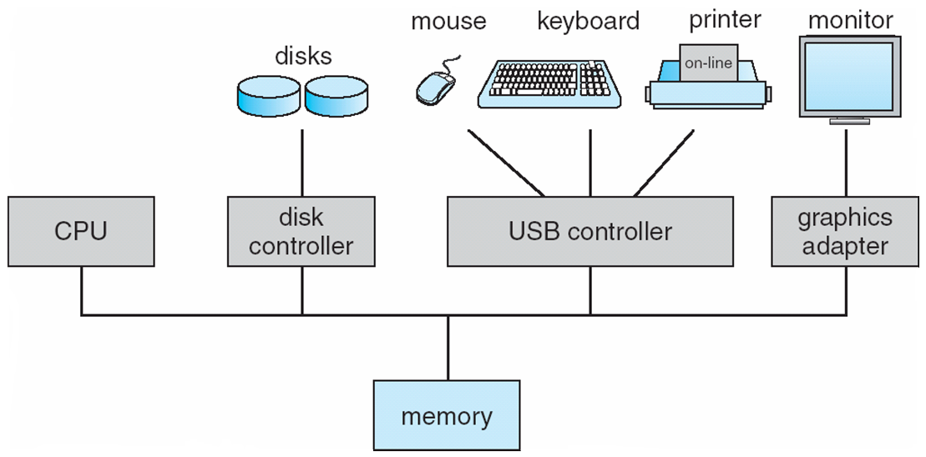
Computer System Organization
Computer-system operation
One or more CPUs, device controllers connect through common bus providing access to shared memory
Concurrent execution of CPUs and devices competing for memory cycles
COURSE SUPERVISOR: ANAUM HAMID

Slide 13
Computer-System Operation
I/O devices and the CPU can execute concurrently
Each device controller is in charge of a particular device type
Each device controller has a local buffer
CPU moves data from/to main memory to/from local buffers
I/O is from the device to local buffer of controller
Device controller informs CPU that it has finished its operation by causing an INTERRUPT
COURSE SUPERVISOR: ANAUM HAMID

Slide 14
Interrupts
Interrupt: a mechanism by which other modules (I/O, memory) may interrupt the “normal sequencing of the processor”.
Most common classes of Interrupts are:
I/O | Generated by an I/O controller, to signal normal completion of an operation or to signal a variety of error conditions.
Program | Generated by a condition that occurs as a result of an instruction execution, such as arithmetic overflow, division by zero, attempt to execute an illegal machine instruction, and reference outside a user’s allowed memory space.
Timer | Generated by a timer within the processor.
Hardware failure | Generated by a failure, such as memory error.
COURSE SUPERVISOR: ANAUM HAMID

Slide 15
Common Functions of Interrupts
Interrupt transfers control to the interrupt service routine generally, through the interrupt vector, which contains the addresses of all the service routines
Interrupt architecture must save the address of the interrupted instruction
A trap or exception is a software-generated interrupt caused either by an error or a user request
An operating system is interrupt driven
COURSE SUPERVISOR: ANAUM HAMID

Slide 16
Interrupt Handling
The operating system preserves the state of the CPU by storing registers and the program counter
Determines which type of interrupt has occurred:
polling
vectored interrupt system
Separate segments of code determine what action should be taken for each type of interrupt
COURSE SUPERVISOR: ANAUM HAMID

Slide 17
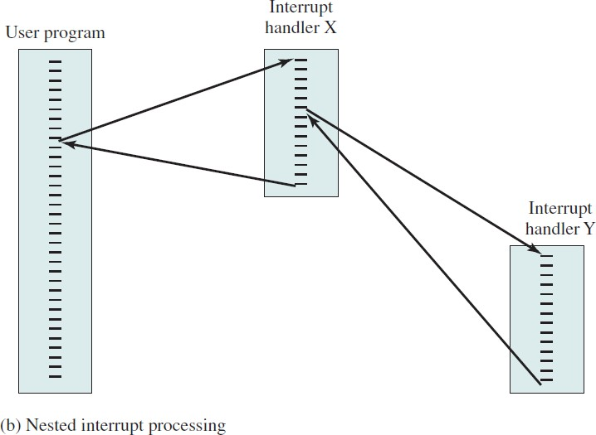
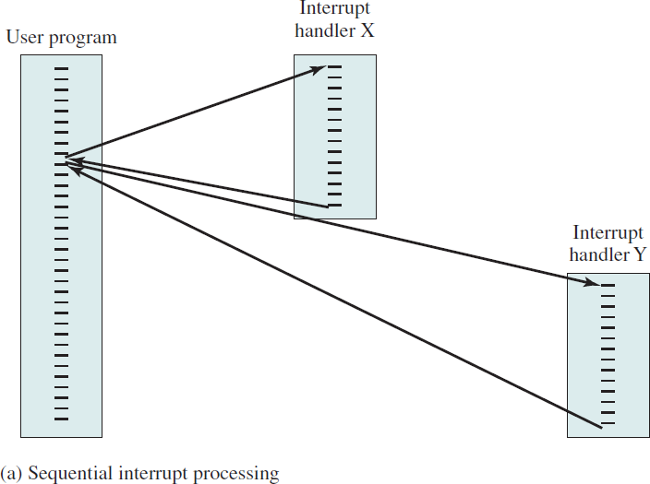
Multiple Interrupts
COURSE SUPERVISOR: ANAUM HAMID

Slide 18
I/O Structure
After I/O starts, control returns to user program only upon I/O completion
Wait instruction idles the CPU until the next interrupt
Wait loop (contention for memory access)
At most one I/O request is outstanding at a time, no simultaneous I/O processing.
After I/O starts, control returns to user program without waiting for I/O completion
System call – request to the OS to allow user to wait for I/O completion
Device-status table contains entry for each I/O device indicating its type, address, and state
COURSE SUPERVISOR: ANAUM HAMID

Slide 19
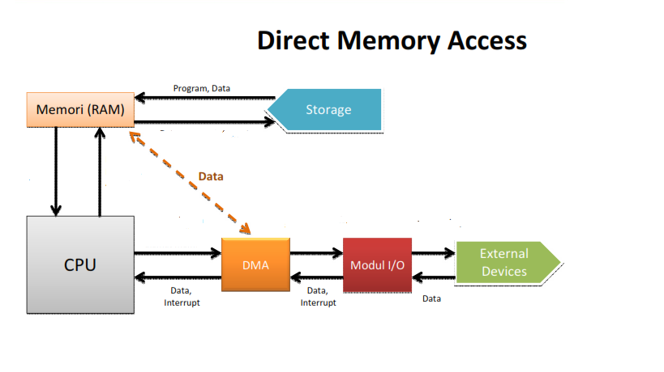
Direct Memory Access Structure
Used for high-speed I/O devices able to transmit information at close to memory speeds
Device controller transfers blocks of data from buffer storage directly to main memory without CPU intervention
Only one interrupt is generated per block, rather than the one interrupt per byte
COURSE SUPERVISOR: ANAUM HAMID

Slide 20
Storage Structure
Main memory – only large storage media that the CPU can access directly
Secondary storage – extension of main memory that provides large nonvolatile storage capacity.
Magnetic disks – rigid metal or glass platters covered with magnetic recording material
Disk surface is logically divided into tracks, which are subdivided into sectors
The disk controller determines the logical interaction between the device and the computer
COURSE SUPERVISOR: ANAUM HAMID

Slide 21
Storage Hierarchy
Storage systems organized in hierarchy
Speed
Cost
Volatility
1. Caching – copying information into faster storage system; main memory can be viewed as a cache for secondary storage
2. Device Driver for each device controller to manage I/O
Provides uniform interface between controller and kernel
COURSE SUPERVISOR: ANAUM HAMID

Slide 22
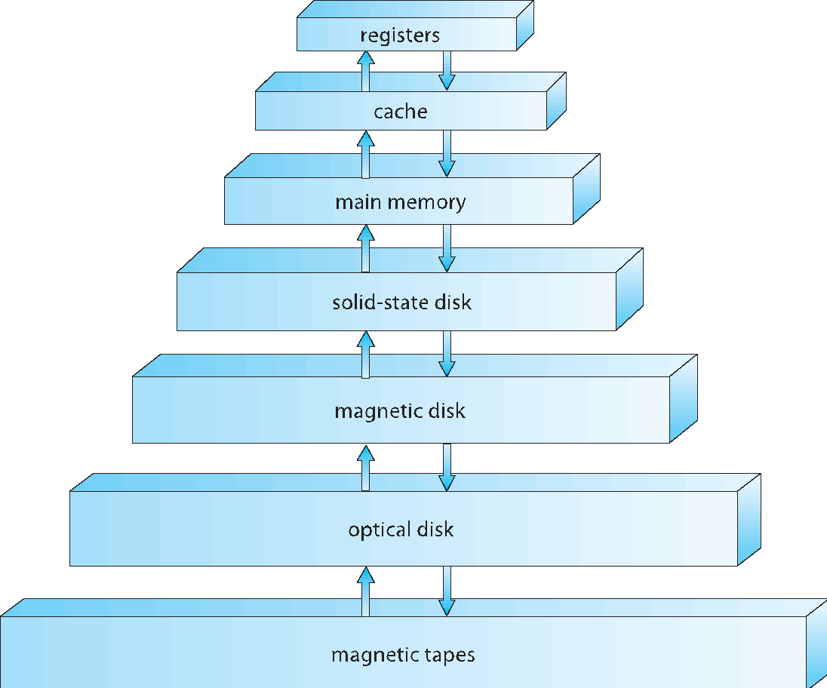
Storage-Device Hierarchy
COURSE SUPERVISOR: ANAUM HAMID

Slide 23
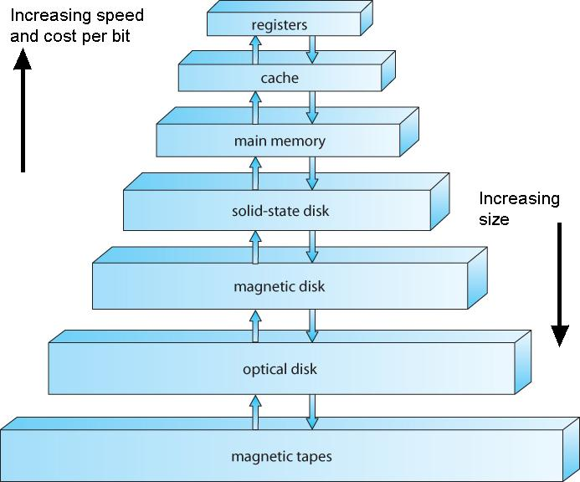
Reg⁻
ister^{s}
^{Inbo}ard
Cac^{he}
^{Mem}ory
Ma^{in}
Me^{mory}
^{Outbo}ard
Ma^{gnetic Disk}
^{Stor}age
CD^{-ROM}
CD^{-RW}
DV^{D-RW}
DV^{D-RAM}
Blu^{-Ray}
^{Off-l}ine
Ma^{gnetic Tape}
^{Stor}age
COURSE SUPERVISOR: ANAUM HAMID

Slide 24
Caching
Important principle, performed at many levels in a computer (in hardware, operating system, software).
Faster storage (cache) checked first to determine if information is there
If it is, information used directly from the cache (fast)
If not, data copied to cache and used there
COURSE SUPERVISOR: ANAUM HAMID

Slide 25
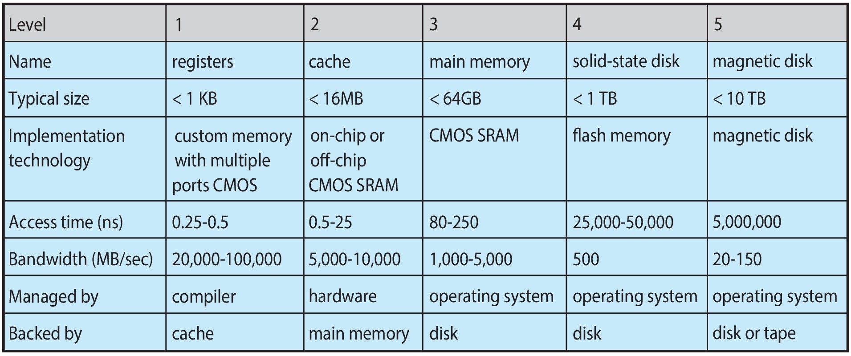
Characteristics of Various Types of Storage
Movement between levels of storage hierarchy can be explicit or implicit

Slide 26
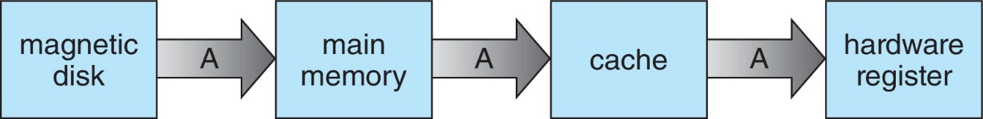
Migration of data “A” from Disk to Register
Multitasking environments must be careful to use most recent value, no matter where it is stored in the storage hierarchy
Multiprocessor environment must provide cache coherency in hardware such that all CPUs have the most recent value in their cache

Slide 27
Computer-System Architecture
Multiprocessor systems growing in use and importance
Also known as parallel systems, tightly-coupled systems
Advantages include:
Increased throughput
Economy of scale
Increased reliability – graceful degradation or fault tolerance
Two types:
Asymmetric Multiprocessing
Symmetric Multiprocessing
COURSE SUPERVISOR: ANAUM HAMID

Slide 28
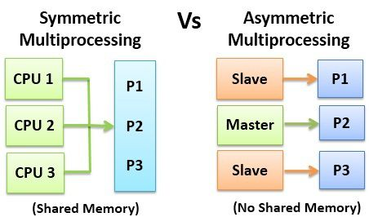
Symmetric vs. Asymmetric Multiprocessing Architecture
COURSE SUPERVISOR: ANAUM HAMID

Slide 29
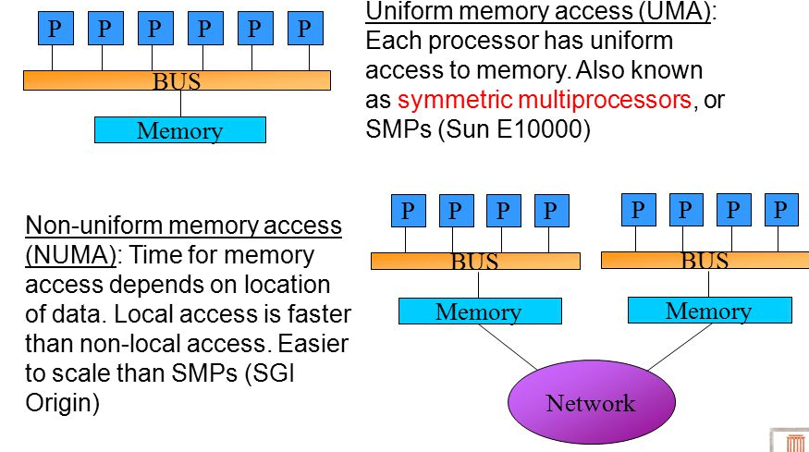
A Dual-Core Design
UMA and NUMA architecture variations
Multi-chip and multicore
COURSE SUPERVISOR: ANAUM HAMID

Slide 30
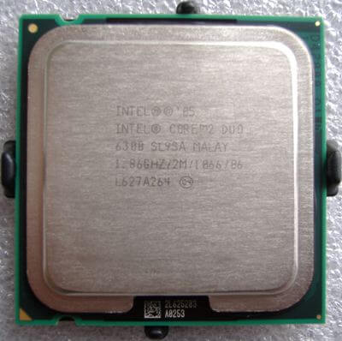
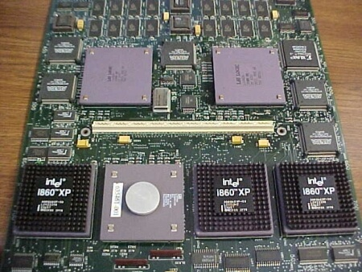
A Dual-Core Design
Multi Chip- Three i860 XP-50 CPUs on a single board
MultiCore- A multicore processor, the Intel Core 2 Duo

Slide 31
Clustered Systems
Like multiprocessor systems, but multiple systems working together
Usually sharing storage via a storage-area network (SAN)
Provides a high-availability service which survives failures
Asymmetric clustering has one machine in hot-standby mode
Symmetric clustering has multiple nodes running applications, monitoring each other
COURSE SUPERVISOR: ANAUM HAMID

Slide 32
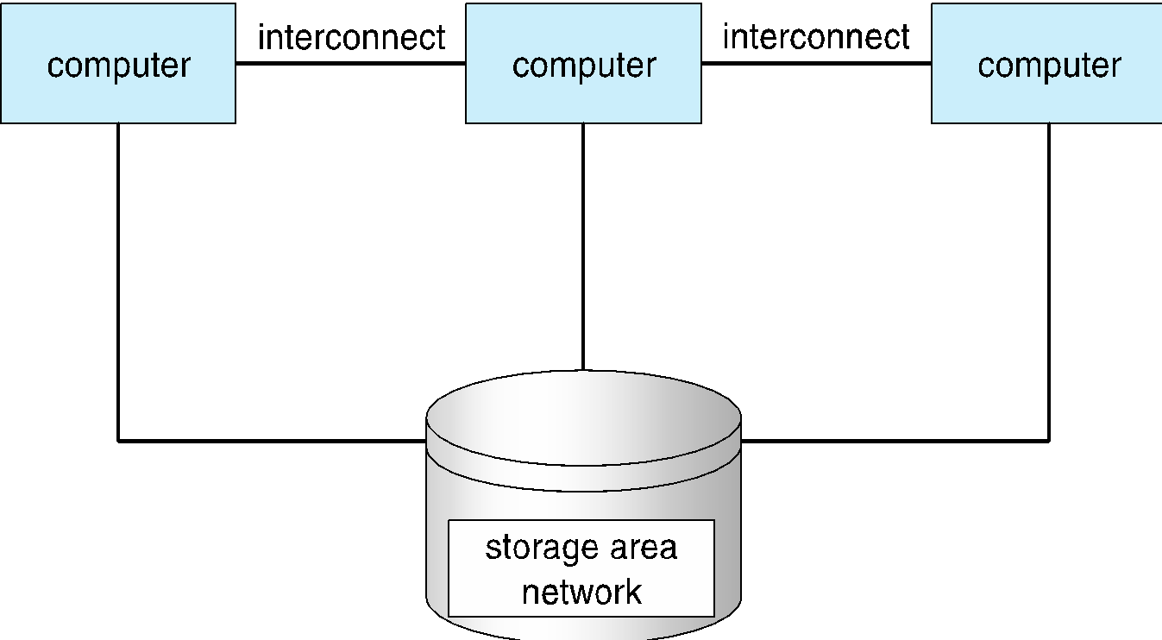
Clustered Systems
COURSE SUPERVISOR: ANAUM HAMID

Slide 33
Operating System Structure
Multiprogramming needed for efficiency
Single user cannot always keep CPU and I/O devices busy
Multiprogramming organizes jobs (code and data) so CPU always has one to execute
A subset of total jobs in system is kept in memory
One job selected and run via job scheduling
When it must wait (for I/O for example), OS switches to another job
Timesharing (multitasking) is logical extension in which CPU switches jobs so frequently that users can interact with each job while it is running, creating interactive computing
Response time should be < 1 second
Each user has at least one program executing in memory 🢡process
If several jobs ready to run at the same time 🢡 CPU scheduling
If processes don’t fit in memory, swapping moves them in and out to run
Virtual memory allows execution of processes not completely in memory
COURSE SUPERVISOR: ANAUM HAMID

Slide 34
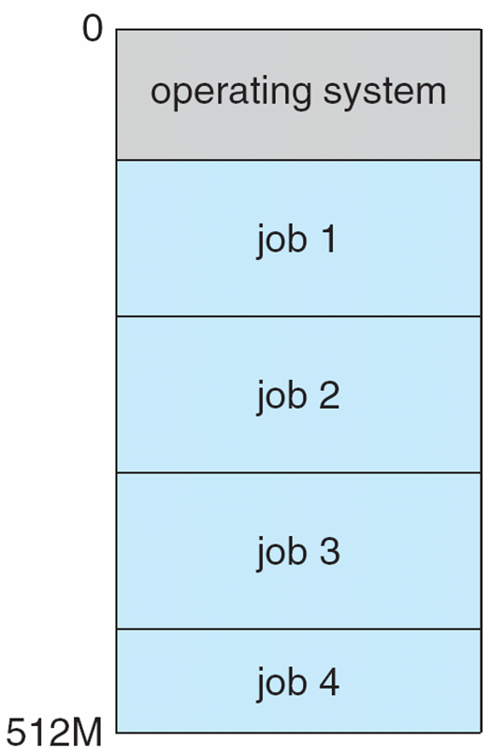
Memory Layout for Multiprogram System
COURSE SUPERVISOR: ANAUM HAMID

Slide 35
Operating-System Operations
Dual-mode operation allows OS to protect itself and other system components
User mode and kernel mode
Mode bit provided by hardware
Provides ability to distinguish when system is running user code or kernel code
Some instructions designated as privileged, only executable in kernel mode
System call changes mode to kernel, return from call resets it to user.
Increasingly CPUs support multi-mode operations
i.e virtual machine manager (VMM) mode for guest VMs.
“The one program running at all times on the computer” is the kernel.
COURSE SUPERVISOR: ANAUM HAMID

Slide 36
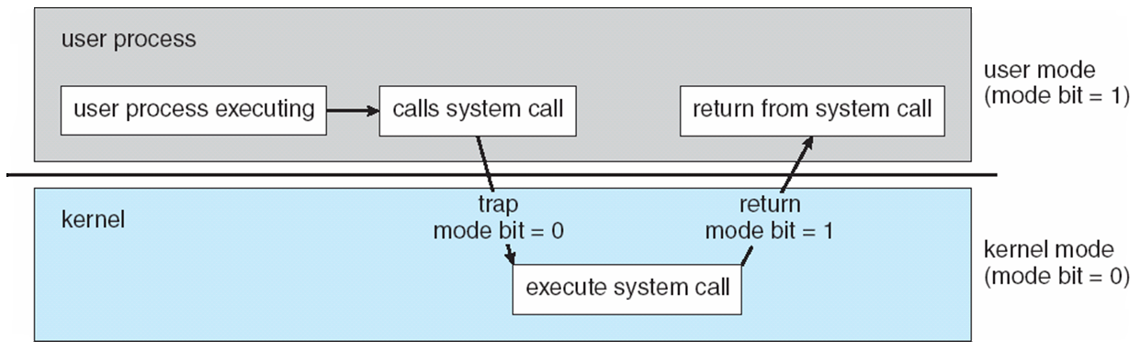
Transition from User to Kernel Mode
Timer to prevent infinite loop / process hogging resources
Set interrupt after specific period
Operating system decrements counter
When counter zero generate an interrupt
Set up before scheduling process to regain control or terminate program that exceeds allotted time

Slide 37
Process Management
A process is a program in execution. It is a unit of work within the system. Program is a passive entity; process is an active entity.
Process needs resources to accomplish its task
CPU, memory, I/O, files
Initialization data
Program counter (PC): Contains the address of an instruction to be fetched
Single-threaded process has one program counter specifying location of next instruction to execute
Multi-threaded process has one program counter per thread
COURSE SUPERVISOR: ANAUM HAMID

Slide 38
Process Management Activities
The operating system is responsible for the following activities in connection with process management:
Creating and deleting both user and system processes
Suspending and resuming processes
process synchronization
process communication
deadlock handling
COURSE SUPERVISOR: ANAUM HAMID

Slide 39
Memory Management
Memory management activities
Keeping track of which parts of memory are currently being used and by whom
Deciding which processes (or parts thereof) and data to move into and out of memory
Allocating and deallocating memory space as needed
COURSE SUPERVISOR: ANAUM HAMID

Slide 40
Storage Management
File-System management
Files usually organized into directories
Access control on most systems to determine who can access what
OS activities include
Creating and deleting files and directories
Primitives to manipulate files and dirs
Mapping files onto secondary storage
Backup files onto stable (non-volatile) storage media
COURSE SUPERVISOR: ANAUM HAMID

Slide 41
Mass-Storage Management
OS activities
Free-space management
Storage allocation
Disk scheduling
Some storage need not be fast
Tertiary storage includes optical storage, magnetic tape.
Still must be managed – by OS or applications
Varies between WORM (write-once, read-many-times) and RW (read-write)
COURSE SUPERVISOR: ANAUM HAMID

Slide 42
I/O Subsystem
I/O subsystem responsible for
Memory management of I/O
caching (storing parts of data in faster storage for performance)
spooling (the overlapping of output of one job with input of other jobs)
COURSE SUPERVISOR: ANAUM HAMID

Slide 43
Protection and Security
Protection – any mechanism for controlling access of processes or users to resources defined by the OS
Security – defense of the system against internal and external attacks
Huge range, including denial-of-service, worms, viruses, identity theft, theft of service
COURSE SUPERVISOR: ANAUM HAMID

Slide 44
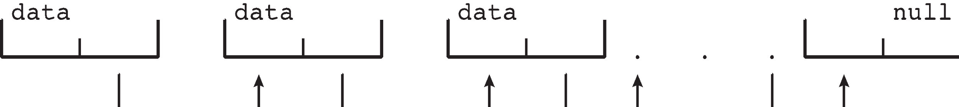
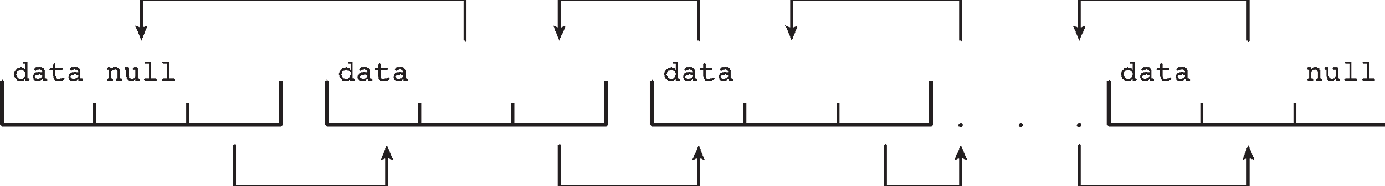
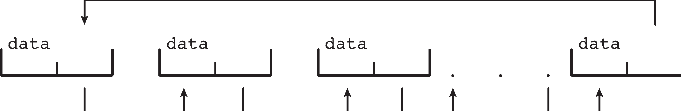
Kernel Data Structures
Linux data structures defined in include files <linux/list.h>, <linux/kfifo.h>, <linux/rbtree.h>
Singly linked list
Doubly linked list
Circular linked list
COURSE SUPERVISOR: ANAUM HAMID

Slide 45
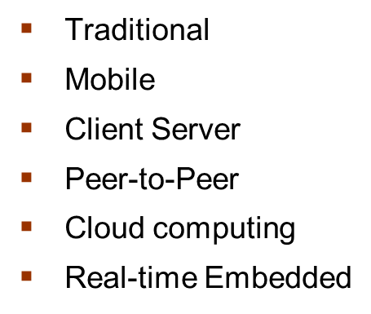
Computing Environments

Slide 46
Computing Environments -Distributed
Distributed
Collection of separate, possibly heterogeneous, systems networked together
Network is a communications path,
Local Area Network (LAN)
Wide Area Network (WAN)
Metropolitan Area Network (MAN)
Personal Area Network (PAN)
Network Operating System provides features between systems across network
COURSE SUPERVISOR: ANAUM HAMID

Slide 47
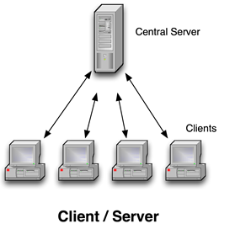
Computing Environments – Client-Server
Client-Server Computing
Dumb terminals supplanted by smart PCs
Many systems now servers, responding to requests generated by clients
COURSE SUPERVISOR: ANAUM HAMID

Slide 48
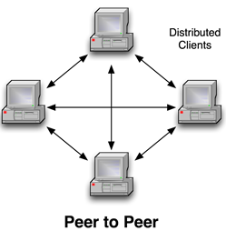
Computing Environments - Peer-to-Peer
Another model of distributed system
P2P does not distinguish clients and servers
COURSE SUPERVISOR: ANAUM HAMID

Slide 49
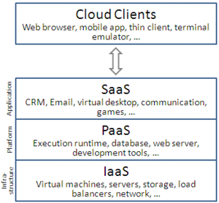
Cloud Computing
Types of Cloud
Public cloud – available via Internet to anyone willing to pay
Private cloud – run by a company for the company’s own use
Hybrid cloud – includes both public and private cloud components.
Software as a Service (SaaS) – one or more applications available via the Internet (i.e., word processor).
Platform as a Service (PaaS) – software stack ready for application use via the Internet (i.e., a database server).
Infrastructure as a Service (IaaS) – servers or storage available over Internet (i.e., storage available for backup use)
COURSE SUPERVISOR: ANAUM HAMID

Slide 50
Real-Time Embedded Systems
Real-time embedded systems most prevalent form of computers
Vary considerable, special purpose, limited purpose OS, real-time OS
Use expanding
Many other special computing environments as well
Some have OSes, some perform tasks without an OS
Real-time OS has well-defined fixed time constraints
Processing must be done within constraint
Correct operation only if constraints met.
Real-time operating system (RTOS) is an operating system intended to serve real time application that process data as it comes in, mostly without buffer delay. The full form of RTOS is Real time operating system.
COURSE SUPERVISOR: ANAUM HAMID

Slide 51
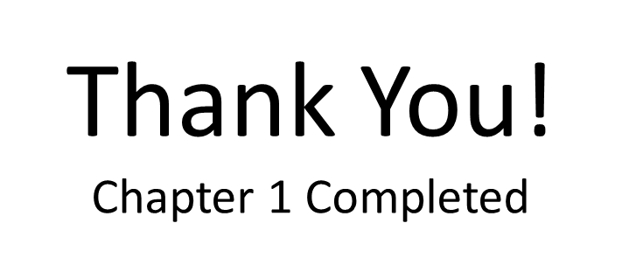
Virtualization
Allows operating systems to run applications within other OSes
OS natively compiled for CPU, running guest OSes also natively compiled
Consider VMware running WinXP guests, each running applications, all on native WinXP host OS
VMM (virtual machine Manager) provides virtualization services
Free and Open-Source Operating Systems
Operating systems made available in source-code format rather than just binary closed-source and proprietary
COURSE SUPERVISOR: ANAUM HAMID

